Slide 1
Energetic compensation breaks down over time in a desert rodent community
Renata M. Diaz and S. K. Morgan Ernest
ESA Annual Meeting, August 2021

Slide 2

Energetic compensation: decreases in abundance of one species are offset by increases from others, so total energy use is maintained.
Notes:
Explain hypothetical scenario
Consistent with zero-sum competition
By definition means community function is more stable than species

Slide 3
Energetic compensation: decreases in abundance of one species are offset by increases from others, so total energy use is maintained.
When is absent, increases in abundance to use 100% of the energy left unused by .
An assemblage without uses the same amount of energy as the complete assemblage.
Notes:
Explain hypothetical scenario
Consistent with zero-sum competition
By definition means community function is more stable than species

Slide 4
When observed, energetic compensation is consistent with a zero sum competitive dynamic.
Energetic compensation renders community-level function less variable than individual species’ abundances.
Notes:
Explain hypothetical scenario
Consistent with zero-sum competition
By definition means community function is more stable than species

Slide 5
For energetic compensation to occur, some species must have identical or overlapping traits relating to both resource use and environmental tolerances.

Slide 6
Compensation is an inherently temporal phenomenon.

Slide 7
Compensation is an inherently temporal phenomenon. Dispersal limitation can delay compensation.

Slide 8
Compensation is an inherently temporal phenomenon. Dispersal limitation can delay compensation. Changing conditions may affect similar competitors in different ways.

Slide 9
Compensation is an inherently temporal phenomenon. Dispersal limitation can delay compensation. Changing conditions may affect similar competitors in different ways.

Slide 10





Notes:
Explain hypothetical scenario
Consistent with zero-sum competition
By definition means community function is more stable than species

Slide 11
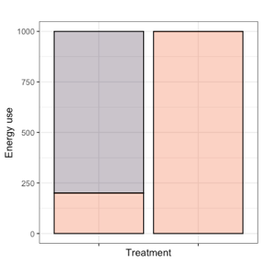
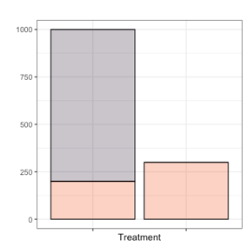
Notes:
Explain hypothetical scenario
Consistent with zero-sum competition
By definition means community function is more stable than species

Slide 12
How do changing environmental conditions modulate energetic compensation over time?

Slide 13
Long-term experiments: The Portal Project
Kangaroo rats
Excluded from experimental plots since 1977
Bailey’s pocket mouse
Established at site ~1996
Small granivores (mostly desert pocket mice)
Present since 1977

Slide 14
Strong compensation began in 1996, driven by C. baileyi ( )
1977 - 1996
1996 - 2010
16% compensation for kangaroo rat removal
Energy use on exclosures 25% of controls
52% compensation for kangaroo rat removal
Energy use on exclosures 67% of controls

Slide 15
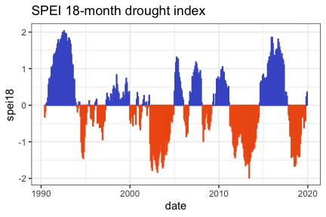
C. baileyi has declined following drought in 2010.

Slide 16
How have these changes impacted energetic compensation?

Slide 17
Other small granivores may now be compensating, in place of C. baileyi
1996 - 2010
Hypothetical 2010-2020

Slide 18
Or, compensation may have broken down.
1996 - 2010
Hypothetical 2010-2020

Slide 19
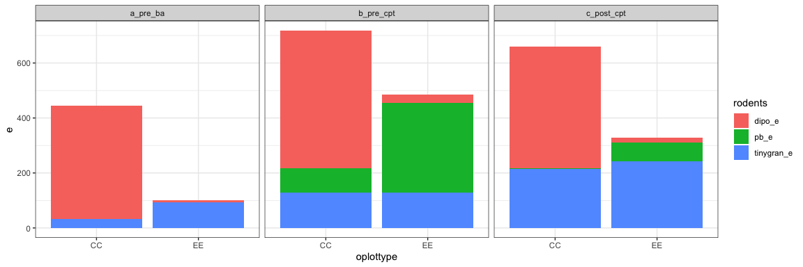
Compensation has declined with C. baileyi.

Slide 20
Under conditions at the site from 1996-2010, C. baileyi was able to compensate for kangaroo rat removal. C. baileyi is still present, but is not abundant enough to compensate for kangaroo rats. Under present conditions, additional factors limit C. baileyi and prevent compensation.

Slide 21
Under conditions ~1996-2010, C. baileyi was able to compensate for kangaroo rat removal. C. baileyi is still present, but is not abundant enough to compensate for kangaroo rats. Under present conditions, additional factors limit C. baileyi and prevent compensation.

Slide 22
Compensation depends not only on the species present but on their match to current environmental conditions.
As conditions change, compensation may come and go within a single assemblage.

Slide 23
Zero-sum competitive dynamics may be intermittent and contingent on changing conditions.
Compensatory dynamics fluctuate over the scale of decades.

Slide 24
Maintenance of community-level function despite species extinctions depends on both the remaining species in an assemblage and their ability to track variable conditions.

Slide 25
Thank you, and I look forward to any questions!

Slide 26
Acknowledgements
NSF funding
UF
Portal Project folks

